Slide 1

2GA3 Tutorial #8
DATE: November 12th, 2021
TA: Jatin Chowdhary

Slide 2
Quick Stuff
Everyone’s asking: ‘‘When will you post tutorial #7 slides?’’
  Answer: In ~1 day (tomorrow)
Tutorial #8 slides will (also) be posted tomorrow
  Why the delay?
    Busy week
    LibreOffice being a pain
    I decided to sleep in this morning
      Thanks Liam!

Slide 3
Review Questions
No time
  I’ll add questions (and answers) in later, and you can review them on your own
Should I double the difficulty of review questions? Or leave them as is?
  Thoughts?

Slide 4
Listen Carefully

Slide 5
Adapt & Improve
Tip Of The Day: Study smarter, not harder
Learn from midterm #1
  What kind of questions were on midterm 1?
    Stuff from lecture, tutorial, assignment, etc.
  What content should you focus on?
    Theoretical questions or calculation questions?
  What was your biggest issue with midterm 1?
    Time? If so, congregate and organize your notes so they are easy to access and reference
      Most of you probably wasted a lot of time going through your unorganized notes and Googling. BAD!

Slide 6
Midterm #2
Mostly on chapter 3 and 4
  Organize your notes based off these 2 chapters
  First 2 questions are chapter 3; last 2 questions are chapter 4
Only 4 questions
  Tip: Think about the questions you’ve done so far?
    IEEE Floating Point
      We did lots of these
    Datapath
      I’ll do another one today
    Pipelining
      This is all from tutorial #8 (today)
    I’ve already given you 3 questions on the midterm! (Kind of)
Y’all better get 100%
  (This is the expectation; rather, what I expect from my sections)

Slide 7
Questions?
Comments?
Concerns?

Slide 8
The Problem
Recently, I realized that most of you are NOT on campus
  Most students are commuting
    I wish I had known sooner! But nobody tells me anything
    I made an incorrect assumption – you can never underestimate how wrong you can be
The problem is: Commuting is a huge time sink
  Hence, nobody wants to do it – including me!
    i.e. A 30 minute commute (one-way) results in 20+ hours wasted every month
      Time >>> Money
  And if I don’t wanna commute, I can’t expect you to do it either

Slide 9
Lesson Learned
And if I don’t wanna commute, I can’t expect you to do it either – at least not in good faith
  Translation: You are not going to do what I tell you to do, you are going to do what you see me do
    i.e. Some students are emailing me at 3-4 AM – which is great
The greatest thing I’ve learned, from you, is:
  Your students/children/employees will NOT do what you tell them to do, rather, what they see you do
    i.e. The early morning emails

Slide 10
The Solution
I have a few ideas
  Should’ve done them sooner
The goal is:
  Break up the content into bits that are easy to learn
    Modularization
    Everyone’s got different questions
  Maximize efficiency and minimize time
  Create long lasting value for everyone
    The answer/solution should be clear, unambiguous, and immediately obvious
This sounds a bit ominous but you’ll see – more to come…

Slide 11
Learning
Time
(Straighten Up)

Slide 12
Quick Tip
Question: How to tell if a number is odd or even in binary?
Answer:
  Look at the last 2 bits!
    This is helpful when the question says, ‘‘round to the nearest even/odd/etc.’’
    You won’t have to convert to decimal, and then back to binary
  If the binary sequence ends in 00 or 10, then it is e___
    Next slide!

Slide 13
Quick Tip
Table of Binary & Decimal Numbers:
Binary | Decimal | Binary | Decimal
0000 0000 | 0 (special case) | 0000 1001 | 9
0000 0001 | 1 | 0000 1010 | 10
0000 0010 | 2 | 0000 1011 | 11
0000 0011 | 3 | 0000 1100 | 12
0000 0100 | 4 | 0000 1101 | 13
0000 0101 | 5 | 0000 1110 | 14
0000 0110 | 6 | 0000 1111 | 15
0000 0111 | 7 | 0001 0000 | 16
0000 1000 | 8 | 0001 0001 | 17

Slide 14
Datapath
I wanna quickly review a question from last week’s tutorial
  Why? Because it’s probably gonna be on the midterm!
    IEEE Floating Points
      We’ve done lot’s of these
    Datapath
      I’ll do one (quickly) right now
    Pipelining
      Today’s tutorial, or what’s left of it
  If you understand these 3 things, you’ll easily get an 85+ on the midterm. The remaining 15% is on YOU!

Slide 15
Review Question (T7)
Question: Refer to datapath.png
Answer:
  4.5.0
    Convert 0x00c6aa23 to binary
      Answer: 110001101010101000100011
        Start at rightmost bits, get instruction (i.e. sw), and then decode the rest
        Use RISC-V instruction list to convert from opcode to instruction
  Remember: 0x00c6aa23 will be stored ‘‘backwards’’ in memory, because RISC-V is little endian
    0x00000008 | 23 aa c6 00
    Address | Value

Slide 16
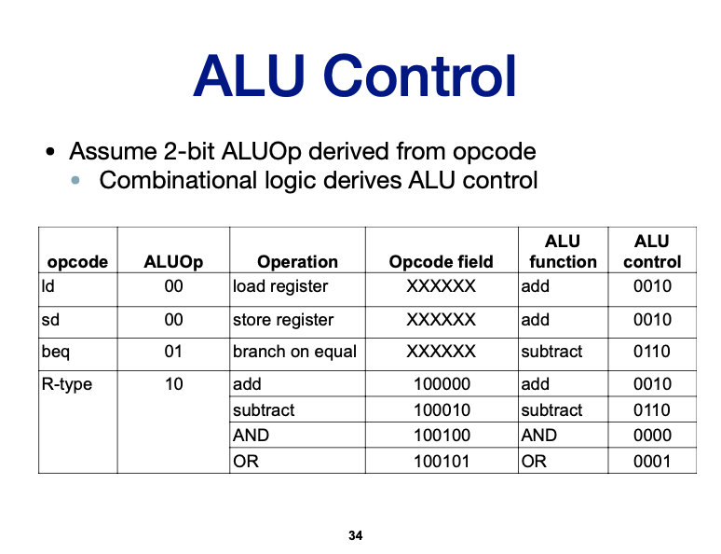
Review Question (T7)
Question: Refer to datapath.png
Answer:
  4.5.1
    From lecture slides!
  What is ALUop?
  What is ALU control?

Slide 17
Review Question (T7)
Question: Refer to datapath.png
Answer:
  4.5.2
    The new program counter address is:
      PCnew = PCold + 4
        4 means 4 bytes
    Since we are not jumping around or anything (i.e. Going to a different function), we simply go to the next instruction
      No branching; so go to next instruction

Slide 18
Review Question (T7)
Question: Refer to datapath.png
Answer:
  4.5.3
    ALUsrc
      Input: x12 (Register), 0x00000014 (Immediate value = 20)
      Output: 0x00000014 (Immediate value = 20)
    MemToReg
      Input: x13 + 0x00000014 (Register + Offset = Memory Address)
      Output: Homework
        Remember, we are not writing to a register

Slide 19
Review Question (T7)
Question: Refer to datapath.png
Answer:
  4.5.4
    Homework

Slide 20
Review Question (T7)
Question: Refer to datapath.png
Answer:
  4.5.5
    Read register 1 = x13
      Base address
    Read register 2 = x12
      The data we are trying to store
    Write register, Write data, RegWrite
      All of them are X, because we are not interested in writing to the register. The sw instruction should not write back
      Note: RegWrite is false

Slide 21
Tutorial Question #1
Question: In this exercise, we examine how pipelining affects the clock cycle time of the processor. Problems in this exercise assume that individual stages of the datapath have the following latencies:
IF | ID | EX | MEM | WB
250 ps | 350 ps | 150 ps | 300 ps | 200 ps
Also, assume that instructions executed by the processor are broken down as follows:
ALU/Logic | Jump/Branch | Load | Store
45% | 20% | 20% | 15%

Slide 22
Tutorial Answer #1
Question: What is the clock cycle time in a pipelined and non-pipelined processor?
Answer:
  Non-pipelined processor
    Add up all the latencies together, because each stage is done sequentially, one at a time
    So, 250 + 350 + 150 + 300 + 200 = 1250 ps
  Pipeline processor
    Find the greatest latency, and that’s your answer
      350 ps

Slide 23
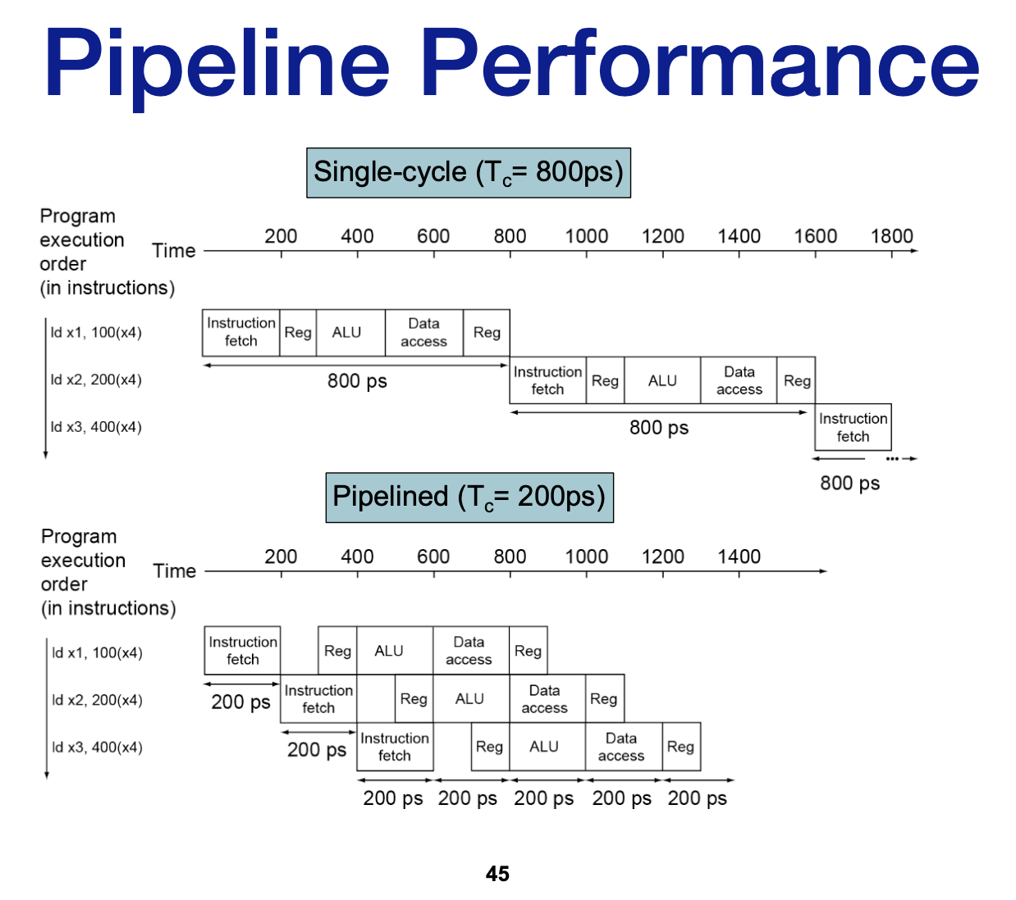
Tutorial Answer #1

Slide 24
Tutorial Answer #1
Question: What is the total latency of an ld instruction in a pipelined and non-pipelined processor?
Answer:
  The TOTAL latency of an ld instruction is the sum of all stages
    250 + 350 + 150 + 300 + 200 = 1250 ps
      Next slide

Slide 25
Tutorial Answer #1

Slide 26
Tutorial Answer #1
Question: If we can split one stage of the pipelined datapath into two new stages, each with half the latency of the original stage, which stage would you split and what is the new clock cycle time of the processor?
Answer: Split the stage/step that takes the longest time
  In this case, it is ID (instruction decode). Then ID is no longer the longest stage, MEM is
  So the clock-cycle time is 300 ps for a pipelined processor

Slide 27
Tutorial Answer #1
Question: Why not split the MEM stage as well?
Answer: There’s always a tradeoff. Similarly, you can’t keep adding more cores to a processor. And you can’t keep increasing the clock speed without encountering thermal and power issues

Slide 28
Tutorial Answer #1
Question: Assuming there are no stalls or hazards, what is the utilization of the data memory?
Answer:
  Go back to question to get breakdown of instructions
  Data memory:Think of load and store
    20 + 15 = 35%

Slide 29
Tutorial Answer #1
Question: Assuming there are no stalls or hazards, what is the utilization of the write-register port of the “Registers” unit?
Answer:
  Writing to register, think of Write Register, Write Data, and RegWrite
    What instruction writes to a register? add
      What’s being used?
        ALU: 45%
        Write back: 20%
  45 + 20 = 65%

Slide 30
Tutorial Question #2
Question: Refer to 420.png
  (Got lazy with the slides. Thanks Liam!)

Slide 31
Tutorial Question #3
Gonna try something different. Stay tuned…

Slide 32
THE END

